Slide 1
Notes:
ok

Slide 2
MeTV is America’s #1 Classic Television Network
MeTV is #1 most widely distributed multicast Network measured by Nielsen (2/5/22NTI)
MeTV is available in 202 U.S. television markets
Covering 99% of TVHHs in America
MeTV is On-air, online, and social media

Slide 3
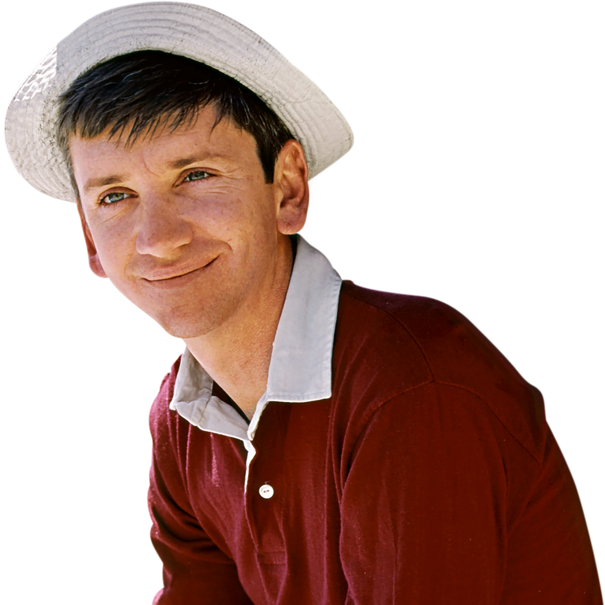
Notes:
Remains true to its brand by delivering Quality programming that is entertaing and provides a safe comfortable environment with engaging. Programming. As we enter the 2nd year of our new normal during this pandemic, people of all ages are are consistently telling us how MeTV has become their safe haven and place to get away from it all.

Slide 4
AUDIENCE SNAPSHOT
22,816,000
533,000
The number of Total Viewers MeTV reaches in an Average Week
Average number of Total Viewers
MeTV delivers, Total Day
#6
1hr 28min
MeTV rank Total Viewers, when compared to 110+ ad-supported cable nets Total Day
The average time spent watching MeTV each day
Source: Nielsen NNTV & NPOWER Live+Same Day; Nov’21

Slide 5
is the Home of
ENGAGED and
PASSIONATE
VIEWERS
Notes:
The meTV viewers is also very present

Slide 6
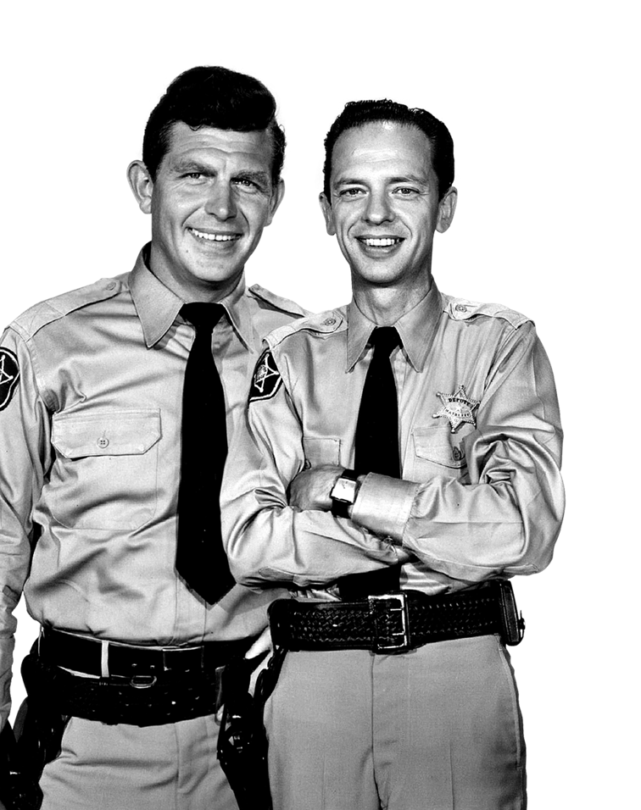
94% OF VIEWING IS LIVE!
Total Day JULY 2021 Adults 25-54
Source: Nielsen NTI JULY’21

Slide 7
94% OF VIEWING IS LIVE!
Primetime JULY 2021 Adults 25-54
Source: Nielsen NTI JULY’21
Source: Nielsen NTI JULY'20. M-Su 6p-12m

Slide 8
VIEWERS FEEL AT HOME AND SPEND MORE TIME WITH
JULY 2021
TIME SPENT VIEWING: Avg days/month
TIME SPENT VIEWING: Avg mins/day
Source: Nielsen NTI JULY ‘21; P2+ who watched at least 6 minutes of the network.

Slide 9
VIEWERS
ARE
VOTERS!
Notes:
The meTV viewers is also very present

Slide 10
MeTV VIEWERS REFLECT VOTERS
% of Adults 18+ | Gender & Age Profiles
Voted in Federal, State, Local Elections*
MeTV A18+ Viewers
Voted in Federal, State, Local Elections*
MeTV A18+ Viewers
WOMEN
MEN
A18-24
A25-34
A35-49
A50-54
A55+
Source: GfK MRI Fusion May'21; * Voted in Federal, State or Local Elections

Slide 11
MeTV VIEWERS REFLECT VOTERS
% of Adults 18+ | Total Day
Percent of Voters* by Major Demo:
Percent of MeTV Viewer by Major Demo:
79%
91%
of Voters are Adults 35+
of MeTV Viewers are Adults 35+
51%
53%
of Voters are Adults 35-64
of MeTV Viewers are Adults 35-64
57%
75%
of Voters are Adults 50+
of MeTV Viewers are Adults 50+
Index of Voters* by Major Demo:
Index of MeTV Viewers by Major Demo:
113
103
123
130
107
163
A35+
A35-64
A50+
A35+
A35-64
A50+
Source: GfK MRI Fusion May'21* Voted in Federal, State or Local Elections

Slide 12
HOW OFTEN VOTED IN AN ELECTION
% of Adults 18+ Me-TV Viewers – Total Day
33.6 million MeTV Viewers A18+ Vote in National Elections “Always/Sometimes”
National Elections
Statewide Elections
Local Elections
111
117
121
Always vote in
National Elections
Always vote in
Statewide Elections
Always vote in
Local Elections
Always
Sometimes
Never
Source: GfK MRI Fusion May'21; * Voted in Federal, State or Local Elections

Slide 13
POLITICAL OUTLOOK & AFFILIATION
Adults 18+ Me-TV Viewers – Total Day
Political Party (if Any) Affiliated with:
Usually Think Of Yourself As:
MeTV Viewers | (000)
Democrat | 13,807
Republican | 13,564
Other party | 521
Independent/No party affiliation | 13,392
MeTV Viewers | (000)
Very Conservative | 7,988
Somewhat Conservative | 8,853
Middle of the Road | 15,023
Somewhat Liberal | 5,912
Very Liberal | 3,220
Civil/Political Engagement Segments (Index):
Source: GfK MRI Fusion May'21

Slide 14
HOW OFTEN VOTED IN AN ELECTION
% of Adults 35+ Me-TV Viewers – Total Day
31 million MeTV Viewers A35+ Vote in National Elections “Always/Sometimes”
National Elections
Statewide Elections
Local Elections
105
108
110
Always vote in
National Elections
Always vote in
Statewide Elections
Always vote in
Local Elections
Always
Sometimes
Never
Source: GfK MRI Fusion May'21; * Voted in Federal, State or Local Elections

Slide 15
POLITICAL OUTLOOK & AFFILIATION
Adults 35+ Me-TV Viewers – Total Day
Political Party (if Any) Affiliated with:
Usually Think Of Yourself As:
MeTV Viewers | (000)
Democrat | 12,634
Republican | 12,781
Other party | 427
Independent/No party affiliation | 11,819
MeTV Viewers | (000)
Very Conservative | 7,525
Somewhat Conservative | 8,227
Middle of the Road | 13,490
Somewhat Liberal | 5,337
Very Liberal | 2,823
Civil/Political Engagement Segments (Index):
Source: GfK MRI Fusion May'21

Slide 16
HOW OFTEN VOTED IN AN ELECTION
% of Adults 35-64 Me-TV Viewers – Total Day
17 million MeTV Viewers A35-64 Vote in National Elections “Always/Sometimes”
National Elections
Statewide Elections
Local Elections
104
106
108
Always vote in
National Elections
Always vote in
Statewide Elections
Always vote in
Local Elections
Always
Sometimes
Never
Source: GfK MRI Fusion May'21; * Voted in Federal, State or Local Elections

Slide 17
POLITICAL OUTLOOK & AFFILIATION
Adults 35-64 Me-TV Viewers – Total Day
Political Party (if Any) Affiliated with:
Usually Think Of Yourself As:
MeTV Viewers | (000)
Democrat | 7,119
Republican | 6,861
Other party | 305
Independent/No party affiliation | 7,492
MeTV Viewers | (000)
Very Conservative | 3,742
Somewhat Conservative | 4,782
Middle of the Road | 8,650
Somewhat Liberal | 2,890
Very Liberal | 1,633
Civil/Political Engagement Segments (Index):
Source: GfK MRI Fusion May'21

Slide 18
HOW OFTEN VOTED IN AN ELECTION
% of Adults 50+ Me-TV Viewers – Total Day
26 million MeTV Viewers A50+ Vote in National Elections “Always/Sometimes”
National Elections
Statewide Elections
Local Elections
102
103
103
Always vote in
National Elections
Always vote in
Statewide Elections
Always vote in
Local Elections
Always
Sometimes
Never
Source: GfK MRI Fusion May'21; * Voted in Federal, State or Local Elections

Slide 19
POLITICAL OUTLOOK & AFFILIATION
Adults 50+ Me-TV Viewers – Total Day
Political Party (if Any) Affiliated with:
Usually Think Of Yourself As:
MeTV Viewers | (000)
Democrat | 10,581
Republican | 10,949
Other party | 296
Independent/No party affiliation | 9,085
MeTV Viewers | (000)
Very Conservative | 6,575
Somewhat Conservative | 6,845
Middle of the Road | 10,702
Somewhat Liberal | 4,372
Very Liberal | 2,185
Civil/Political Engagement Segments (Index):
Source: GfK MRI Fusion May'21

